Slide 1
AWS: EC2
Steps
Carlos Estevez

Slide 2
Steps
Create Account
AWS Management Console
My Account
AWS Management Console {Log in}
Find Services “EC2”
Launch Instance
Community AMI
Search “rstudio” and “aslett”
Select One (Top One)
Choose Free Tier
Next -> Configure {Lower Right}
Add Storage … maybe change to 30Gb
Configure Security Group -> Add Rule
Add Rule
HTTP = MyIP
Review
Launch
Select Key Pair
Launch Instance
View Instances
Copy Paste Public DNS into Browser
“rstudio” is username
Instance ID is the password (copy and paste)
Rstudio Server Should be running!

Slide 3
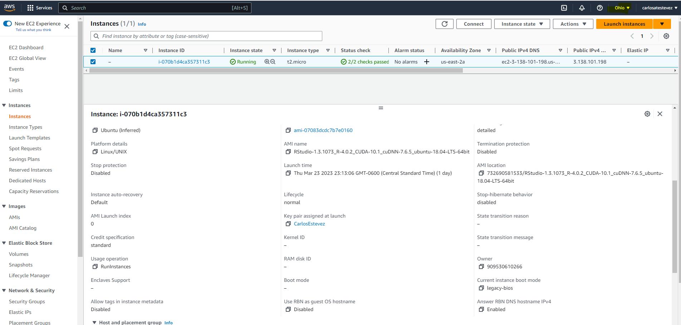
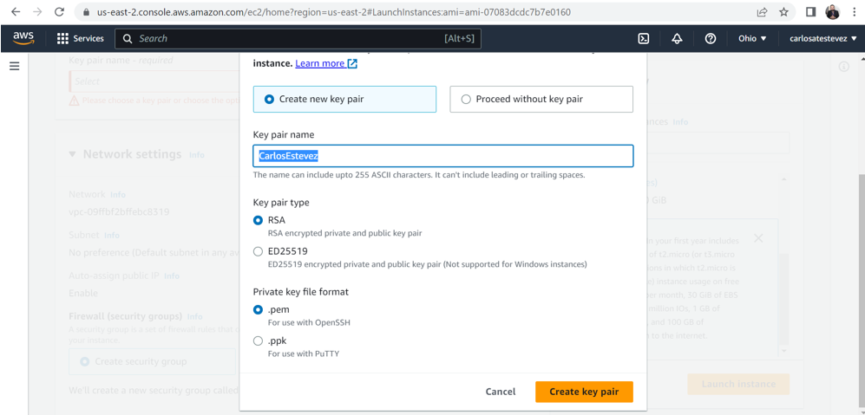
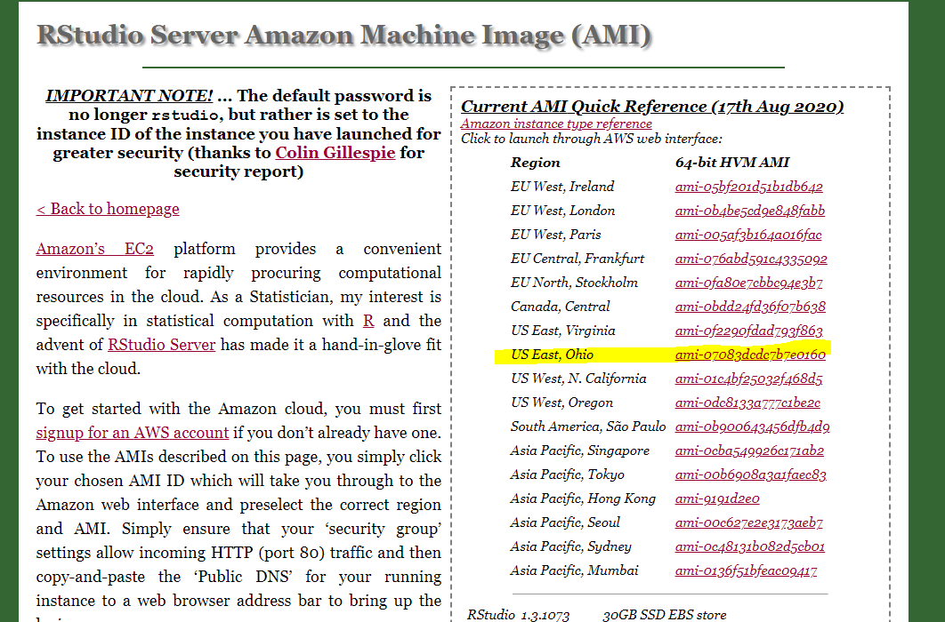
Amazon Rstudio Instance
We created the account: carlos@estevez.do, carlosatestevez
We launched the instance and looked for a AMI called rstudio and aslett
One way to do it faster was going to below website and select the AMI directly
https://www.louisaslett.com/RStudio_AMI/

Slide 4
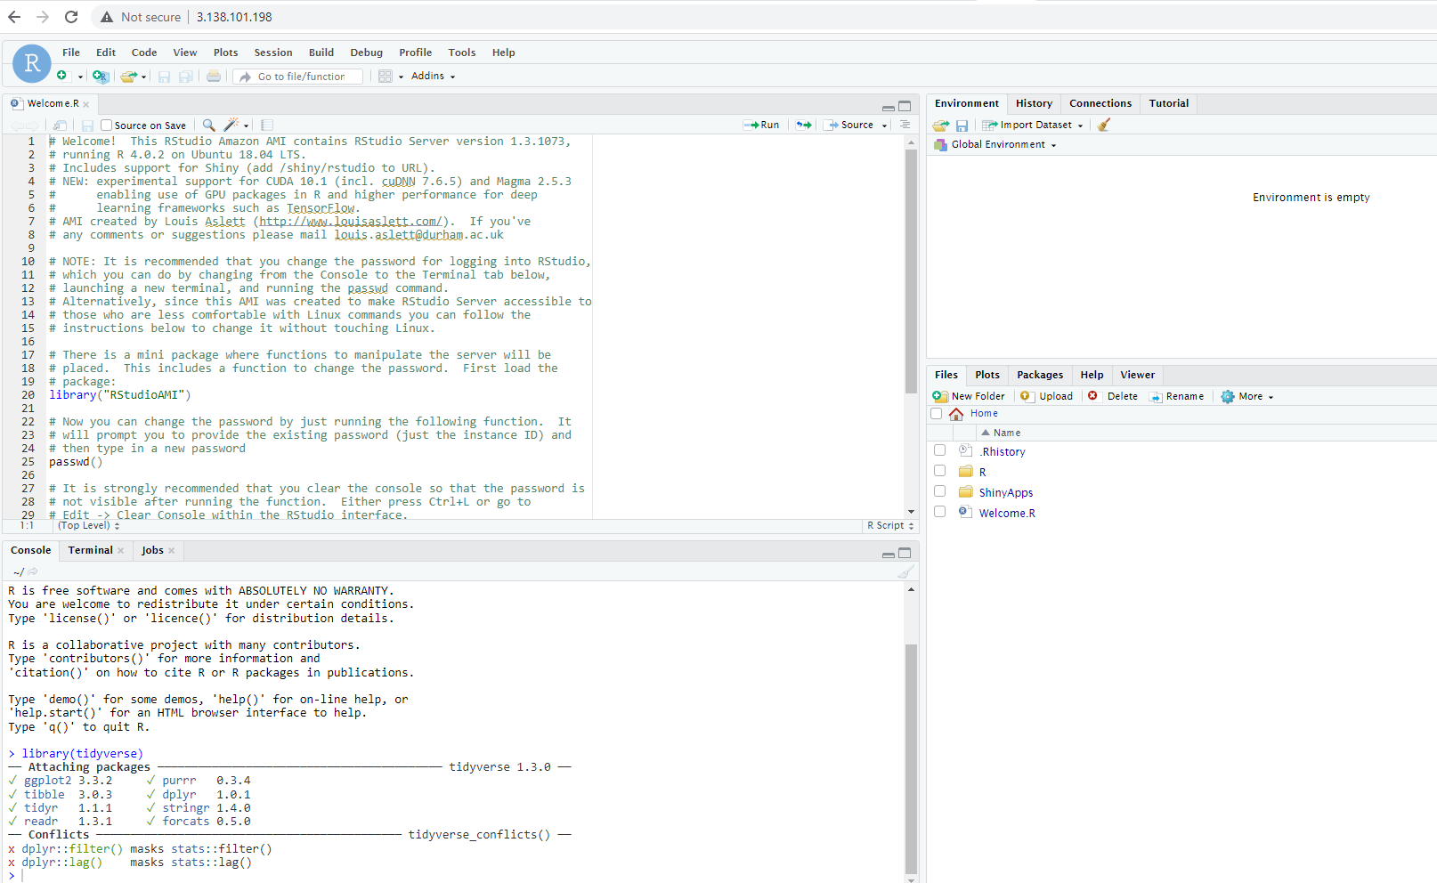
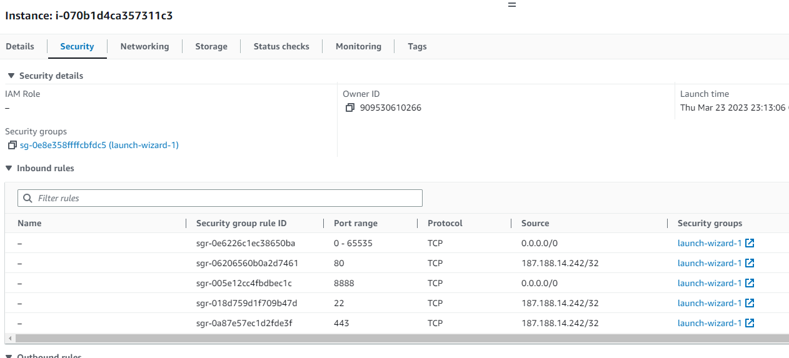
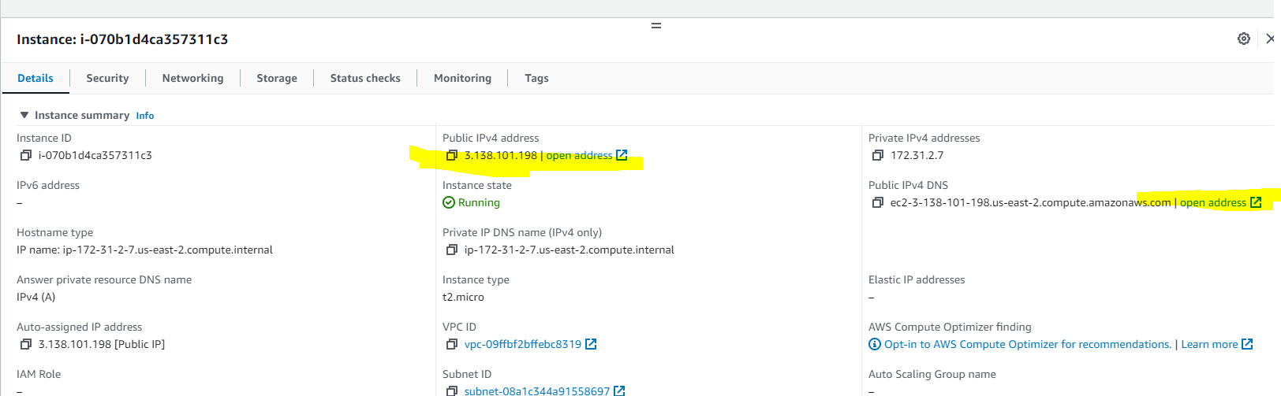
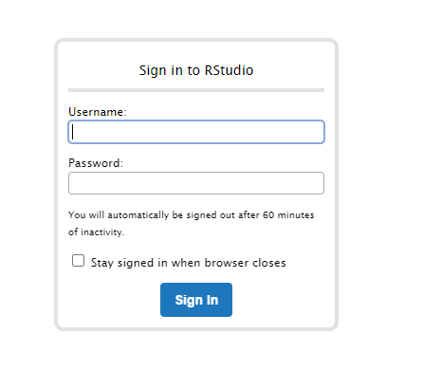
Amazon Rstudio Instance
As we can see in the image Rstudio is running ok
Link:
http://ec2-3-138-101-198.us-east-2.compute.amazonaws.com/auth-sign-in

Slide 5
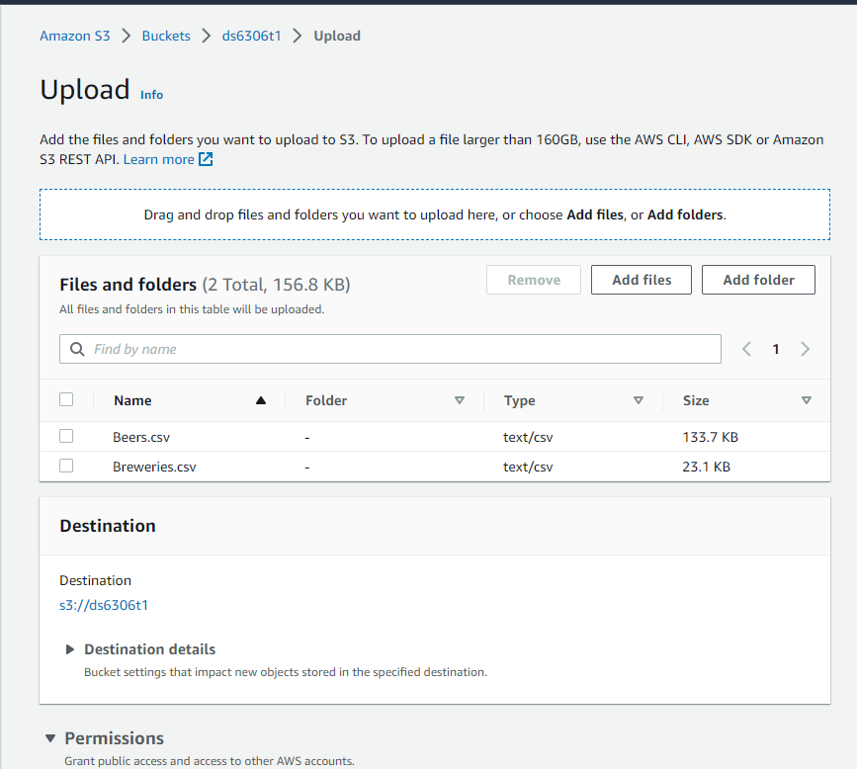
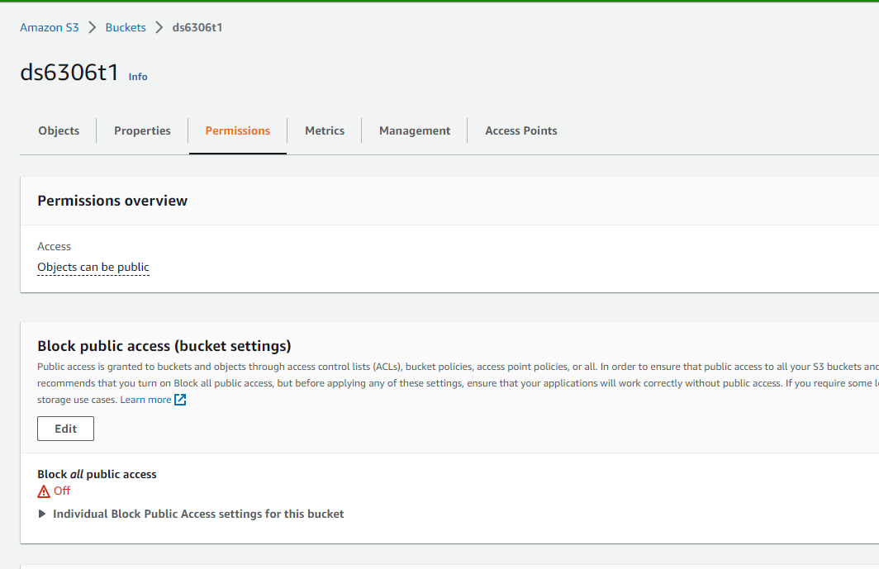
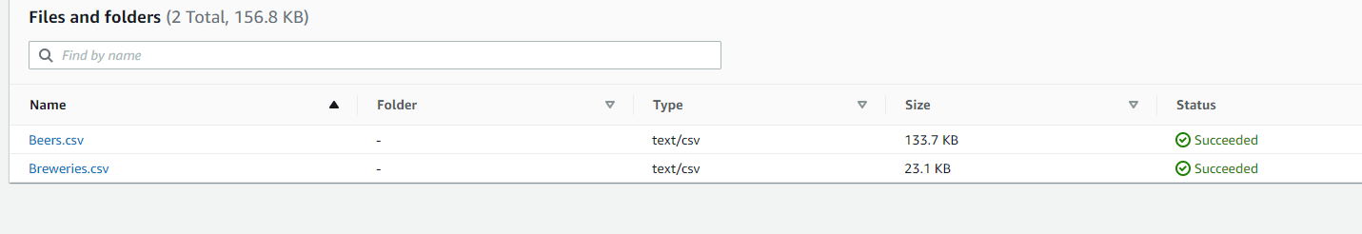
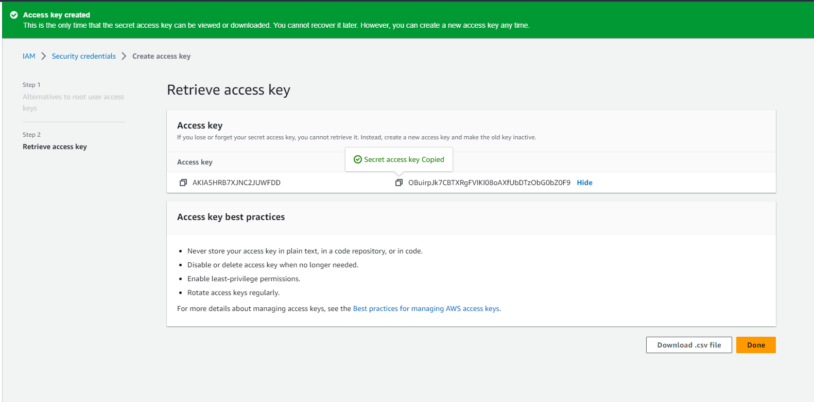
Amazon S3
Account and permissions
Access key
Uploading beers and breweries csv files

Slide 6

Amazon S3
We updated our BeerStudyShinny App by adding the functionality of connecting to Amazon S3 and pulling both datasets from there.
You have to introduce the KeyId, Access key and bucket’s name and the App will automatically connect to S3 and plot both datasets
If we set this checkbox the APP will upload the results of the plots to S3

Slide 7
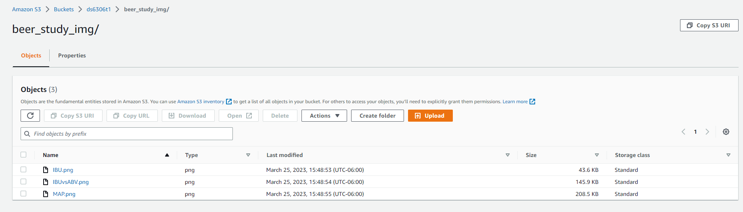
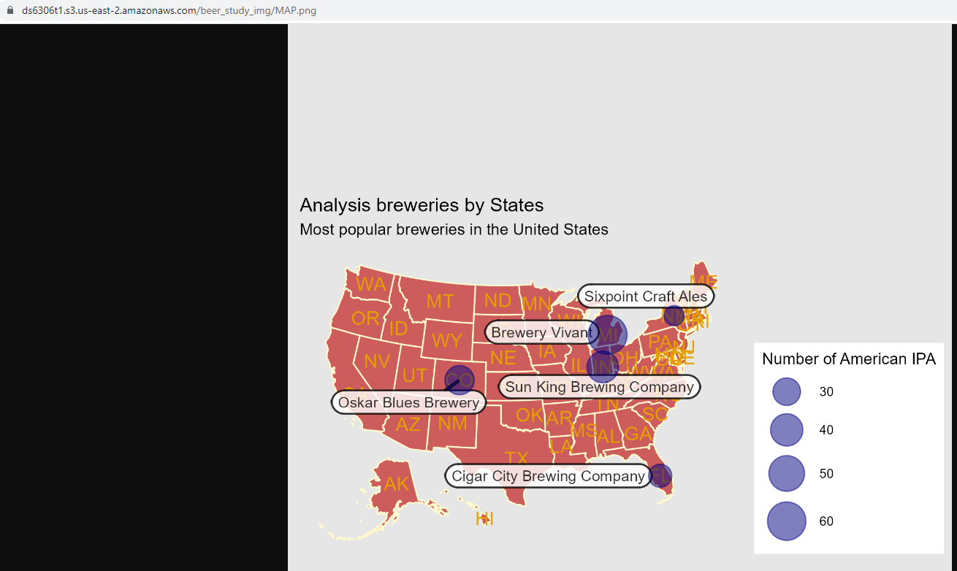
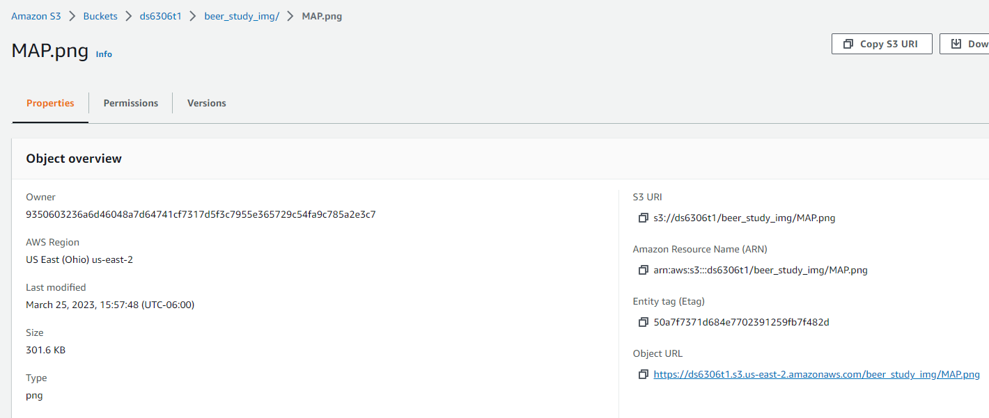
Amazon S3
Plots generated by the APP

Slide 8
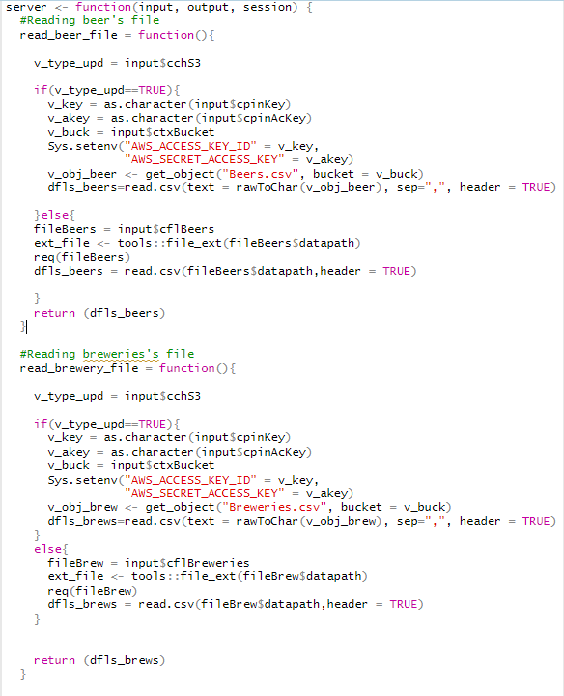

Amazon S3
As you can see from the image, we just had to update the functions that read the datasets
We set the access key and key id
We used the function get_object and pass the object and bucket name
Beers dataset
Breweries dataset

Slide 9
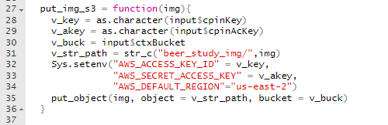
Amazon S3
We used the function put_object to send the images generated by the App to S3

Slide 10
Takeaways
It is awesome to begin to work with AWS
Questions
Have you encountered a situation based on your experience that the processing power of your PC is not enough and you had to resort to use AWS to solve the problem?

